Slide 1


Heart Disease
PRESENTED BY: PIYUSH UPADHYAY

Slide 2
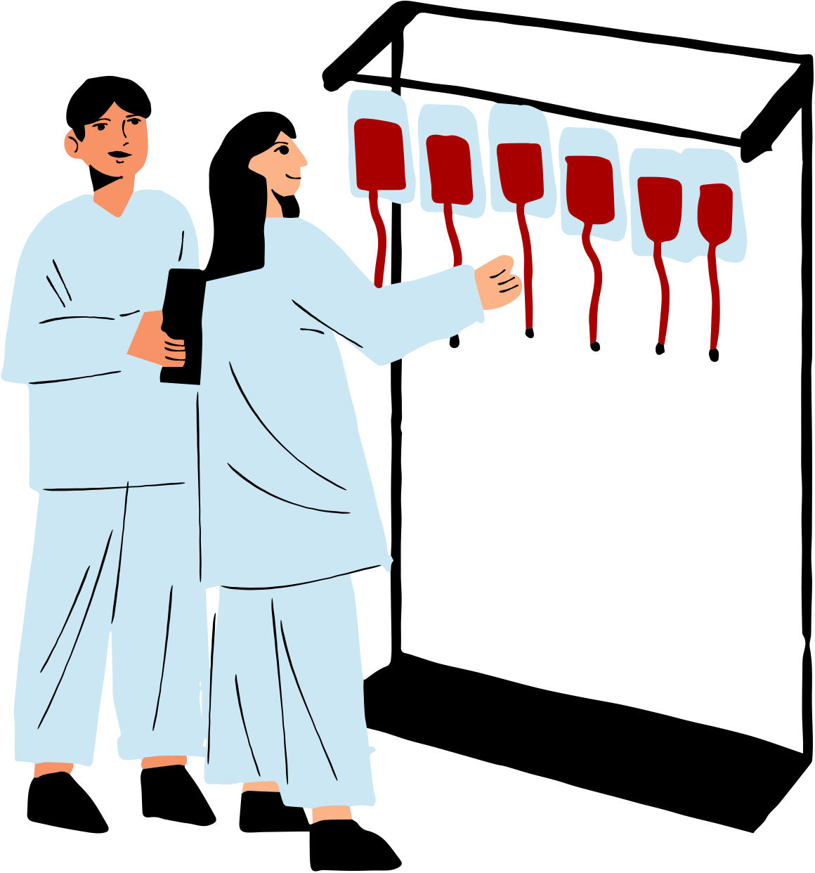
INTRODUCTION
Heart disease is a leading cause of death globally, warranting detailed analysis for insights. This report delves into heart disease data, focusing on how many peoples have this disease, ages of disease peoples and also focus on their genders, chest pain experienced etc. Using advanced analysis and visualization, we aim to extract actionable insights for healthcare strategies. The dataset providing a comprehensive overview. Aiming to inform interventions and reduce heart disease burden.

Slide 3
Problem Statement
Health is real wealth in the pandemic time we all realized the brute effects of covid-19 on all irrespective of any status. You are required to analyze this health and medical data for better future preparation.
Do ETL: Extract- Transform and Load data from the heart disease diagnostic database You can perform EDA through python. The database extracts various information such as Heart disease rates, Heart disease by gender, by age.
You can even compare attributes of the data set to extract necessary information. Make the necessary dashboard with the best you can extract from the data. Use various visualization and features and make the best dashboard.
Find key metrics and factors and show the meaningful relationships between attributes.
Do your own research and come up with your findings.

Slide 4
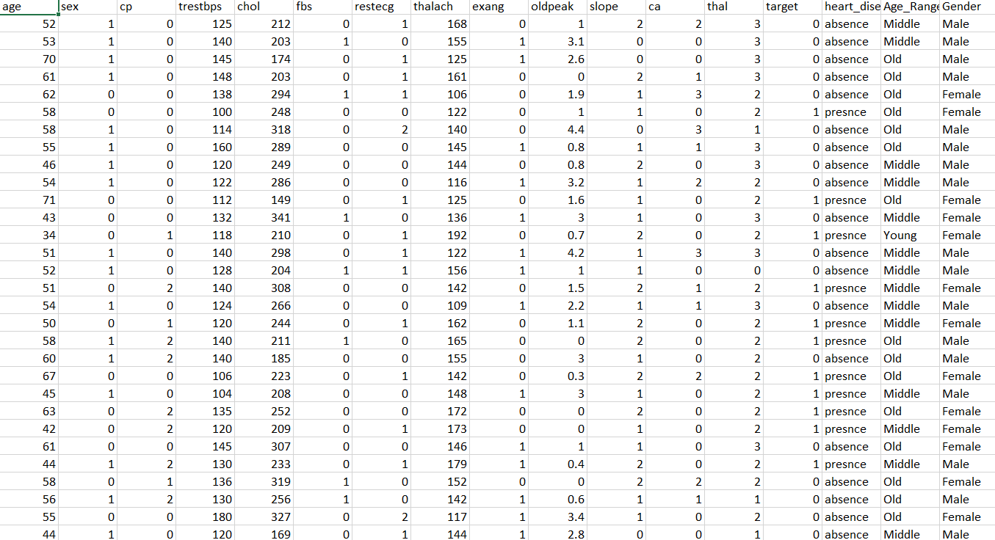
Dataset

Slide 5

Main KPI’s
Difference between People with Disease & not diseased
Visualization based on Age and Gender factor
Heart Disease with Age Category[Young, Middle, Old]
Chest Pain Experienced
Chest Pain based on Age Category
Blood Pressure based on Gender
Cholesterol Level based on Gender

Slide 6
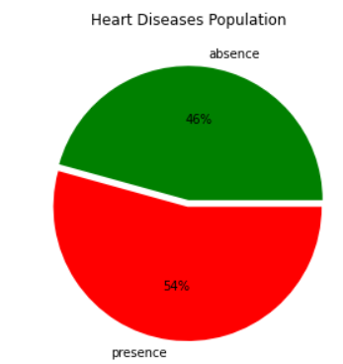
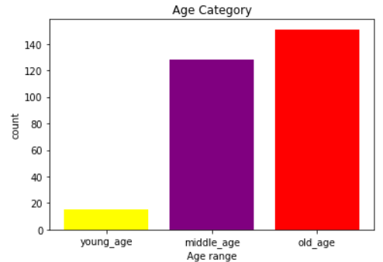
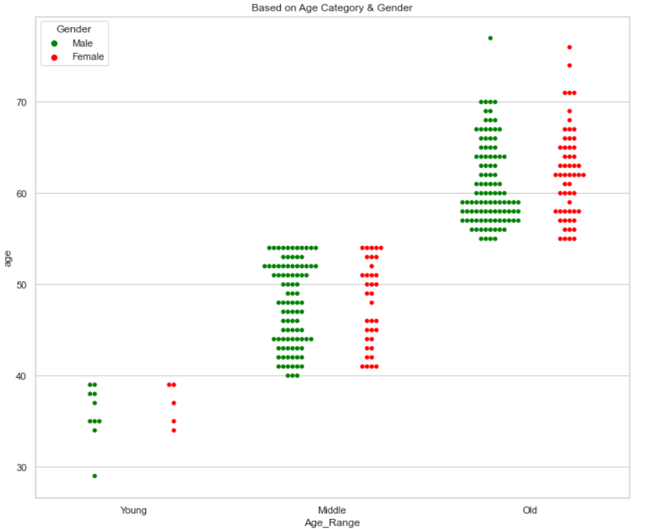
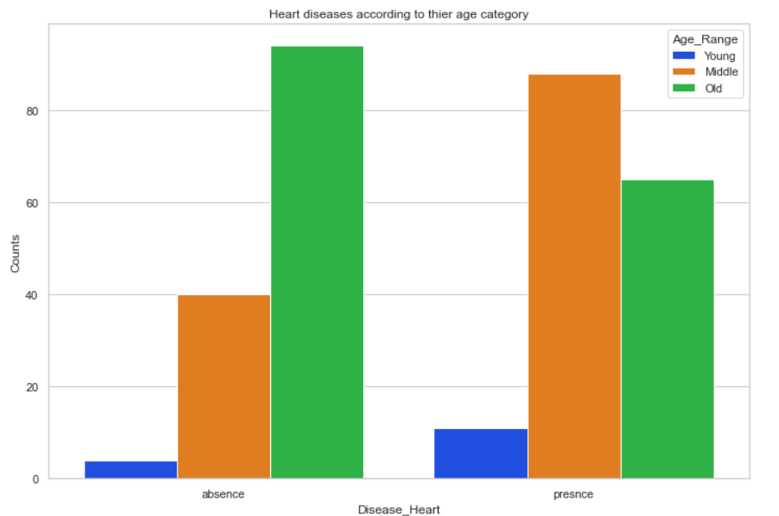
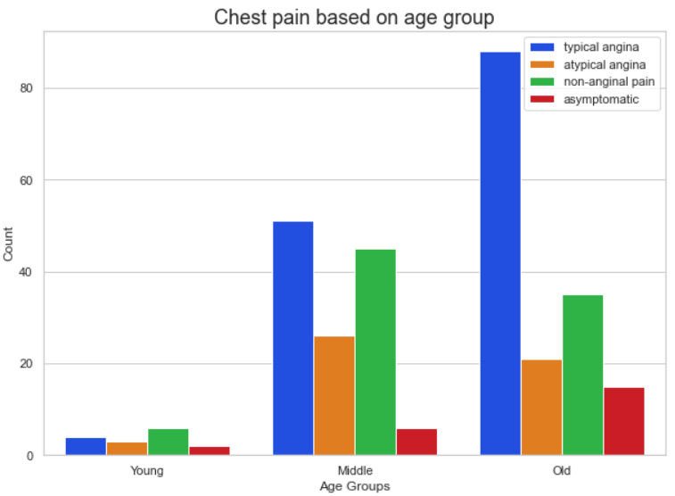
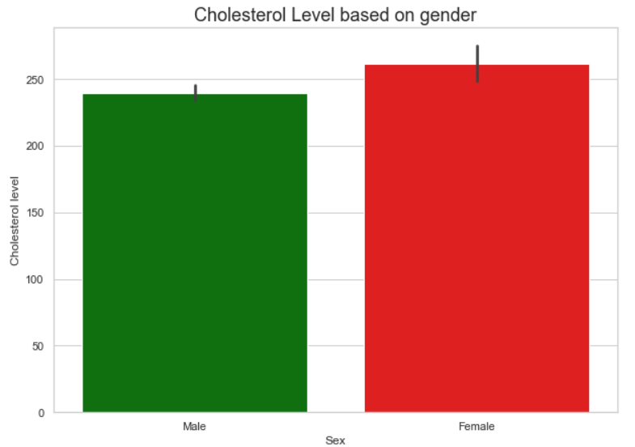
Charts Visualization

Slide 7
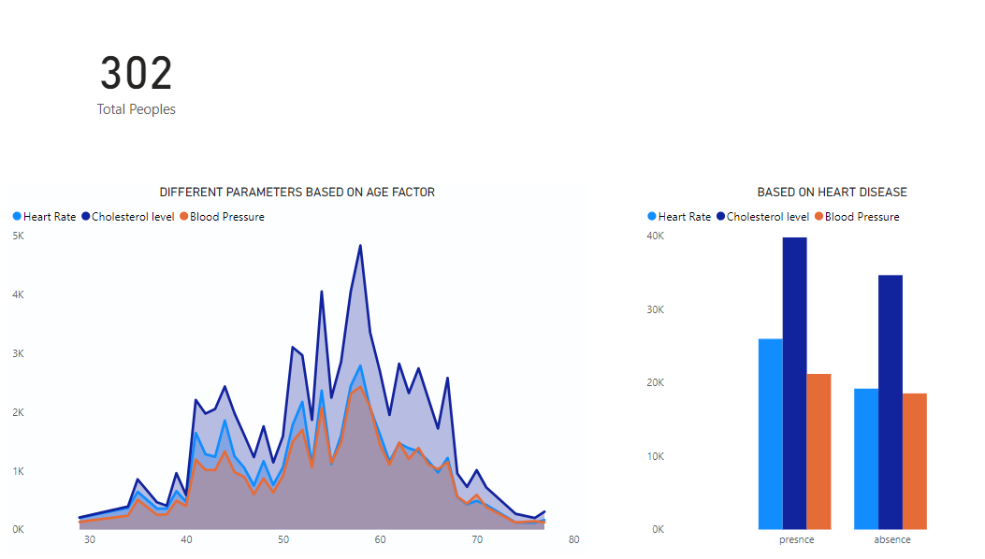
Mock Dashboard

Slide 8
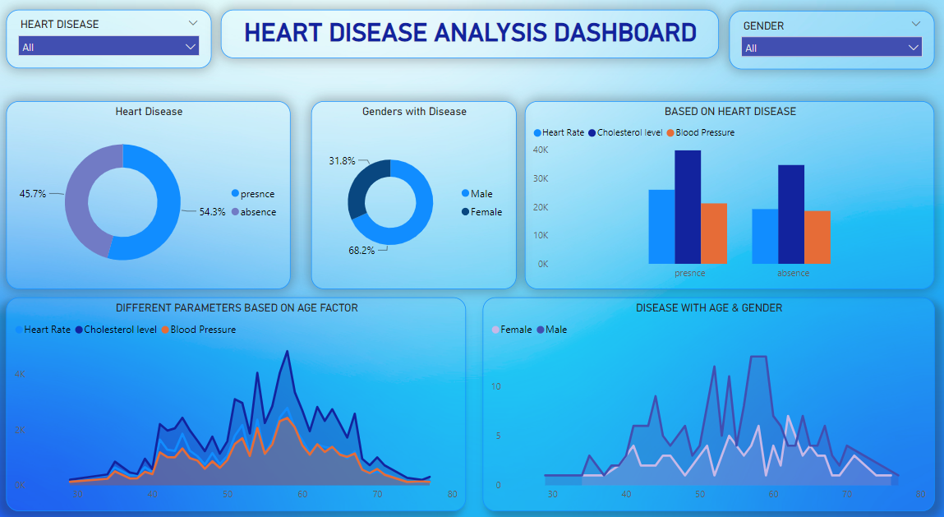
Final Dashboard

Slide 9

IN-SIGHTS
55% of Total Population are defected with Heart Disease in which 56.1% are Males and rest all are Females.
People from 50-55 Age Category are most Heart Disease Patient with the presence of Maximum heart rate, Cholesterol level, also Blood Pressure.
52 Age is on peak with the presence of Heart Disease in which 8 are Males and 1 Female.
High levels of cholesterol are present in big numbers in Most Heart Diseased Peoples as compared to others.
Old Age Category have the most chances of Heart Disease because of high rate of Chest pain.

Slide 10
THANK
YOU!

